Slide 2


ENGINEERING MACHINE LEARNING
HEALTH TECHNOLOGY

Slide 3
MACHINE LEARNING for Health tech
GROUPS

Slide 4
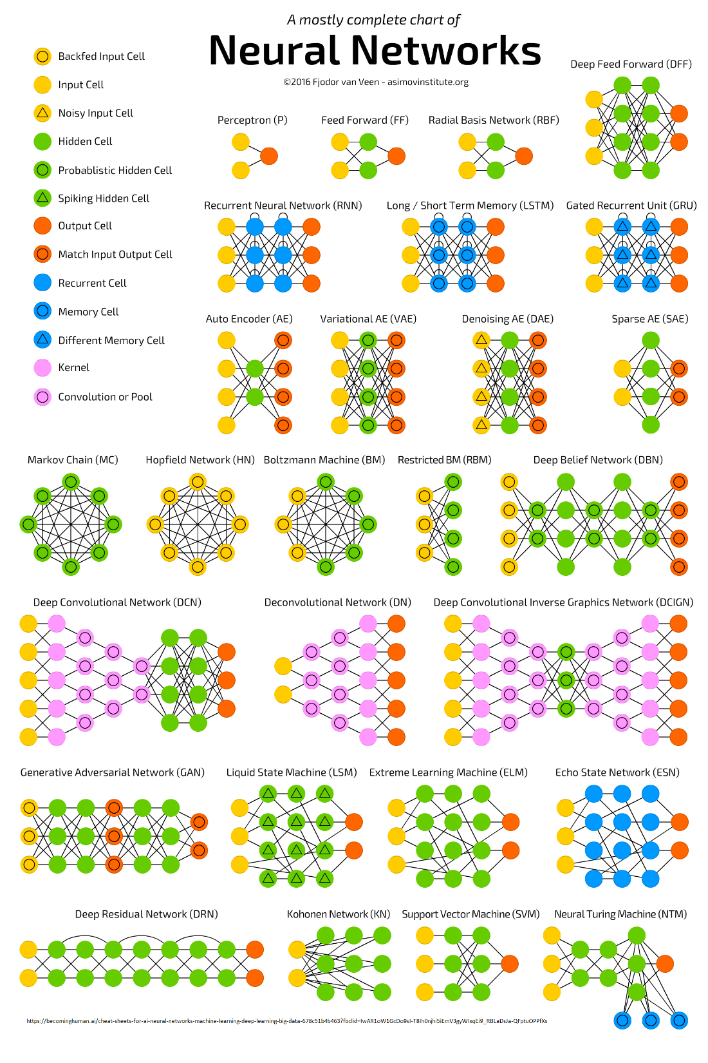
MACHINE LEARNING for Health tech

Slide 5

MACHINE LEARNING for Health tech
END-TO-END

Slide 6
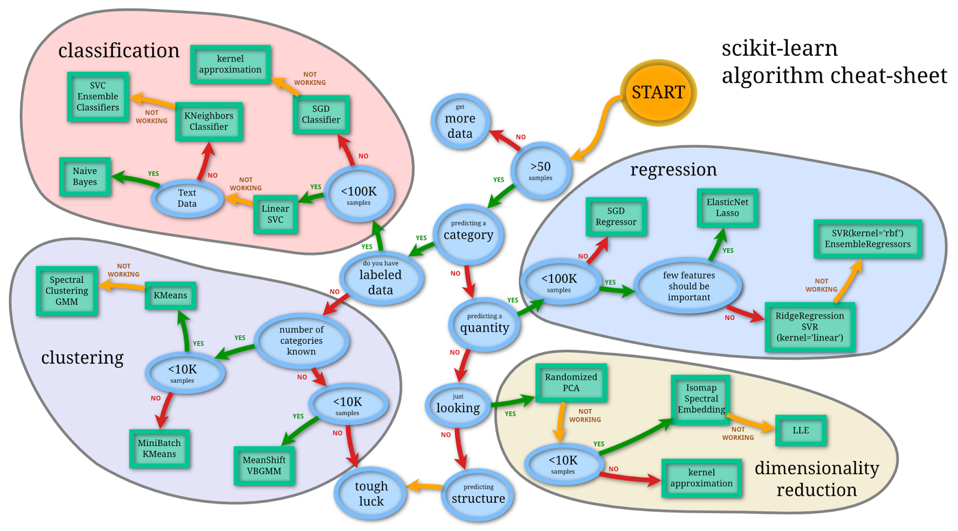
MACHINE LEARNING for Health tech
END-TO-END

Slide 7
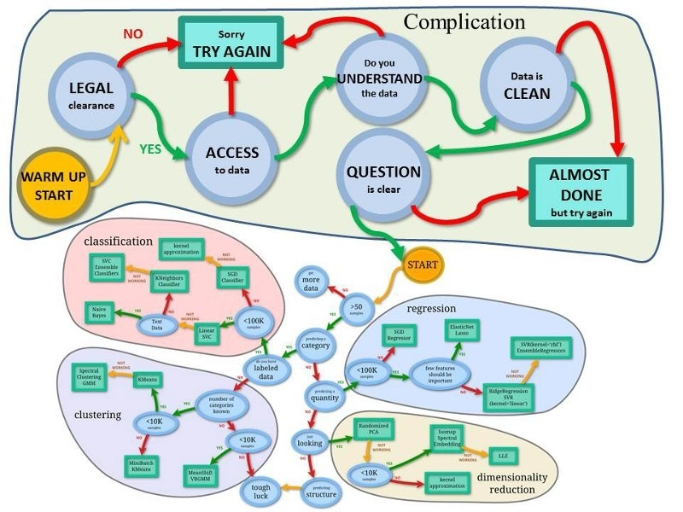
MACHINE LEARNING for Health tech
END-TO-END

Slide 8
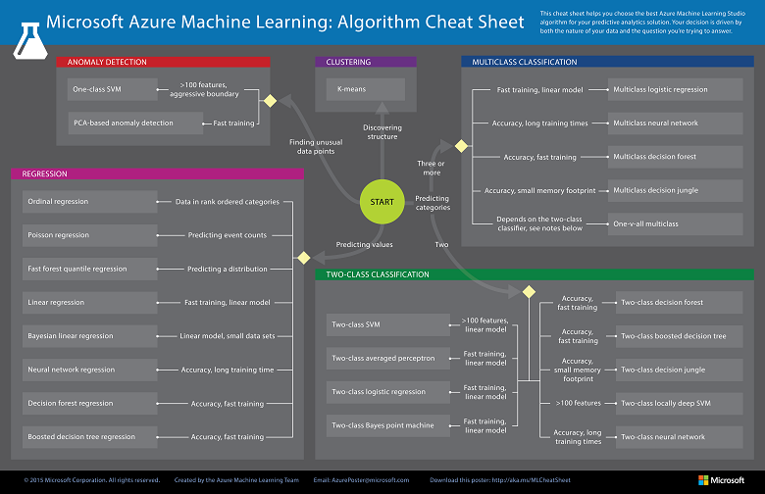
MACHINE LEARNING for Health tech
END-TO-END

Slide 9
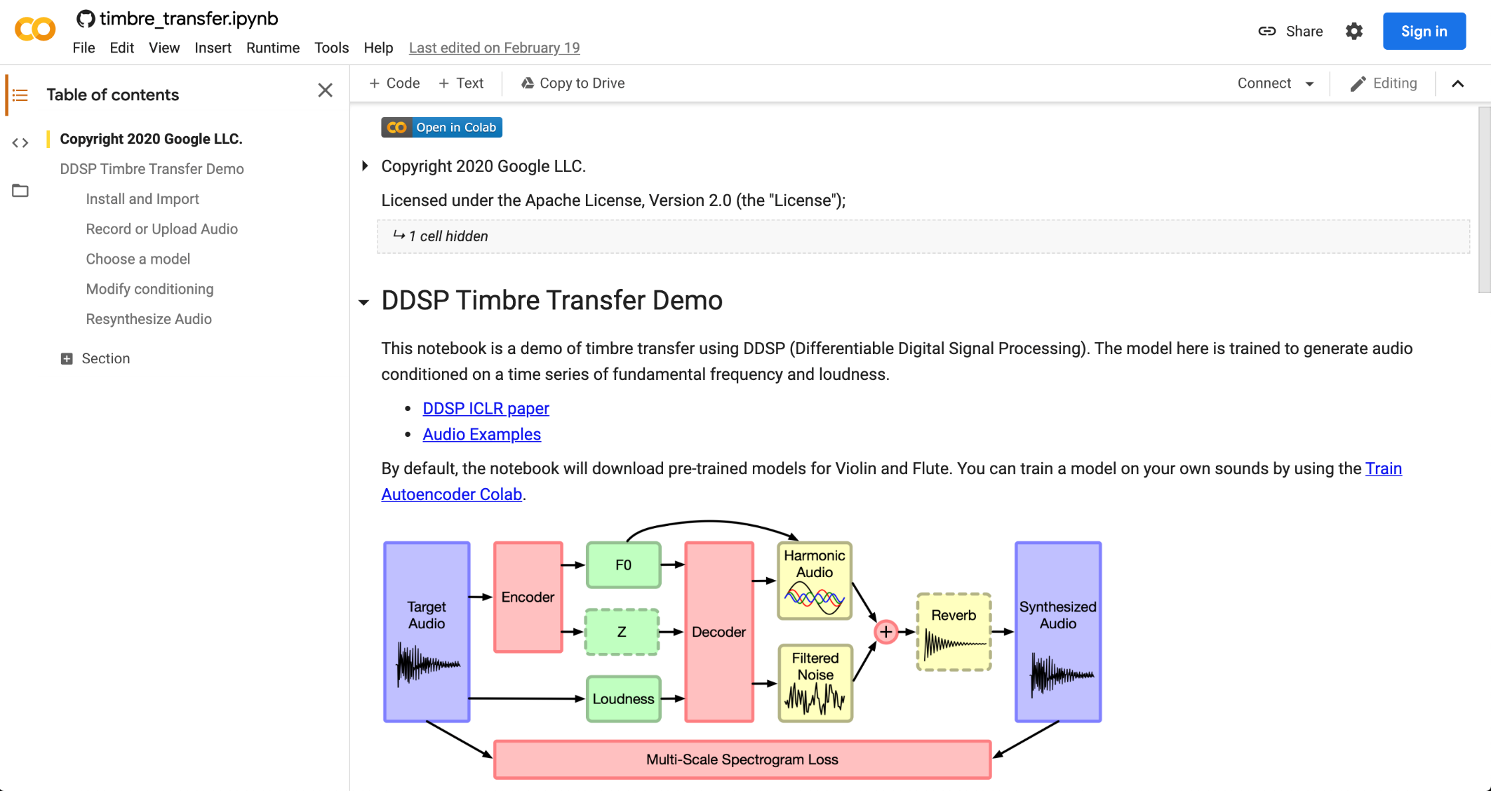

MACHINE LEARNING for Health tech
END-TO-END

Slide 10
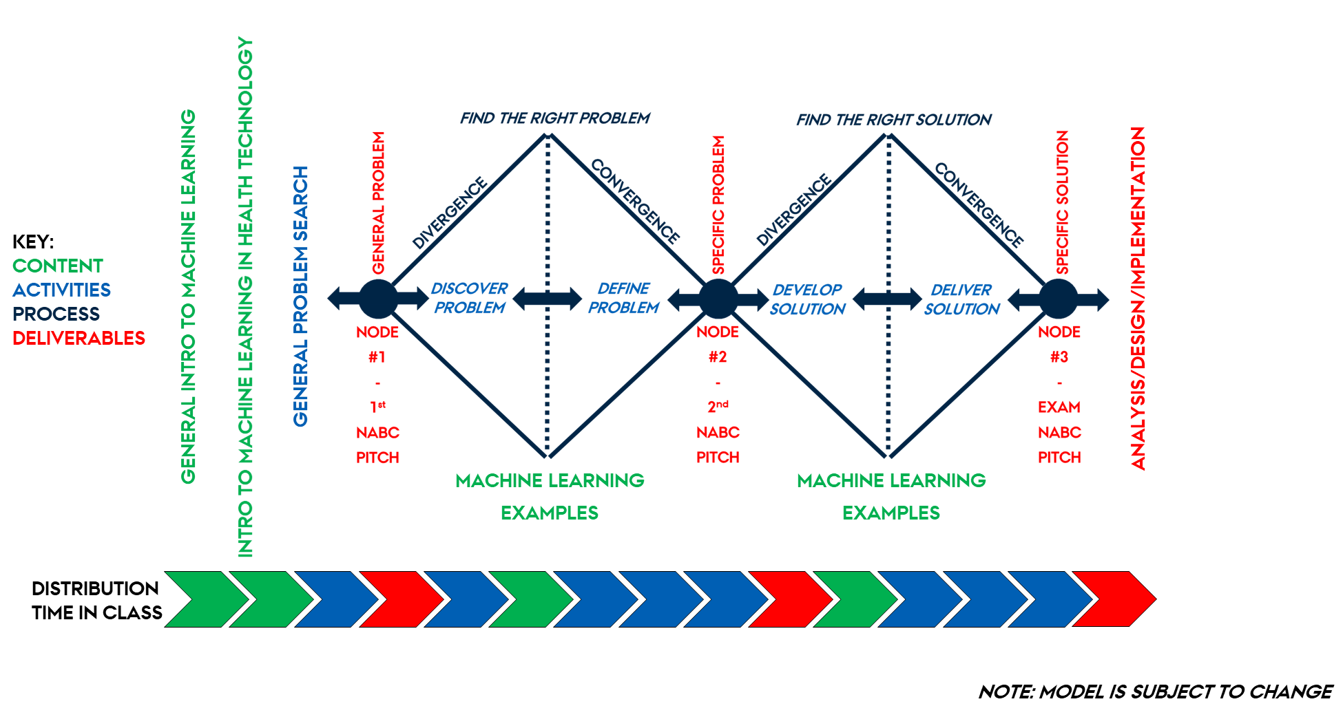
MACHINE LEARNING for Health tech
DOUBLE
DIAMOND

Slide 11
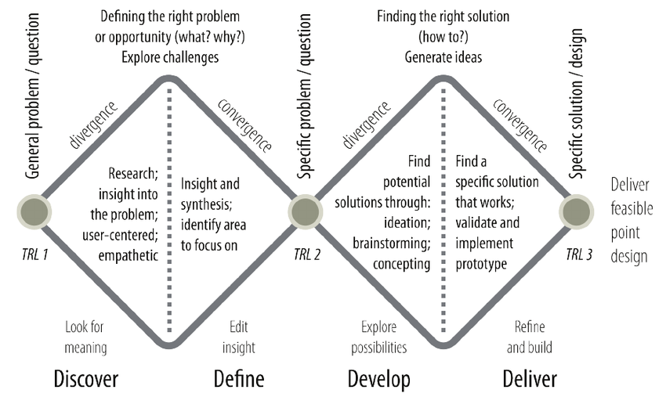
MACHINE LEARNING for Health tech
DOUBLE
DIAMOND

Slide 12
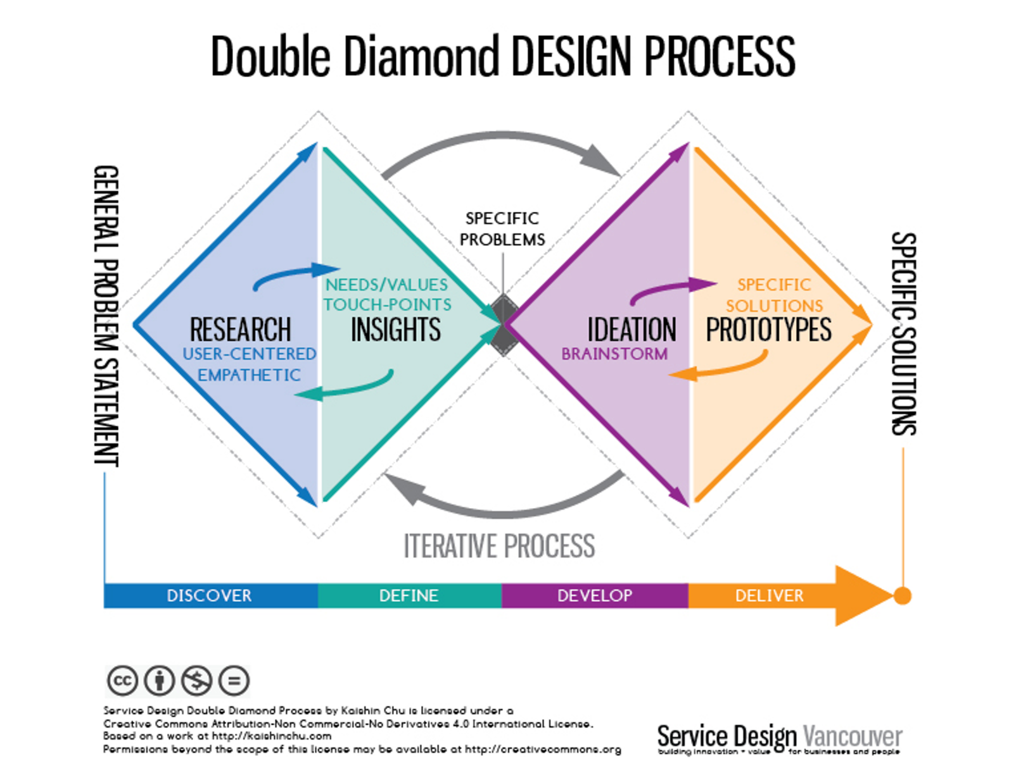
MACHINE LEARNING for Health tech
DOUBLE
DIAMOND

Slide 13
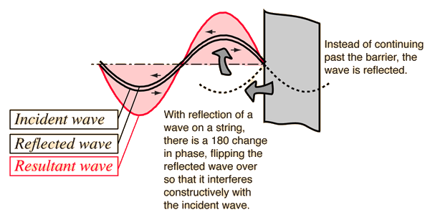
MACHINE LEARNING for Health tech
DOUBLE
DIAMOND

Slide 14
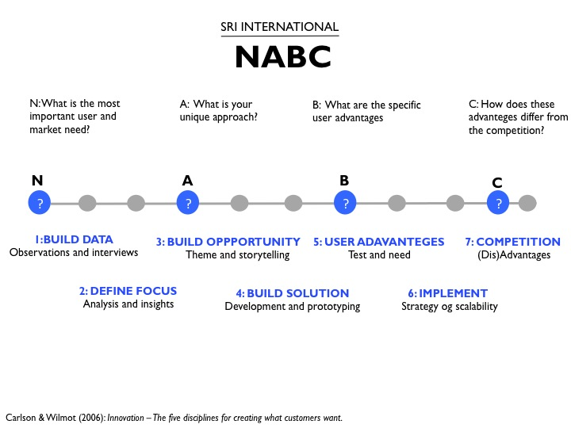
MACHINE LEARNING for Health tech
NABC PITCH

Slide 15
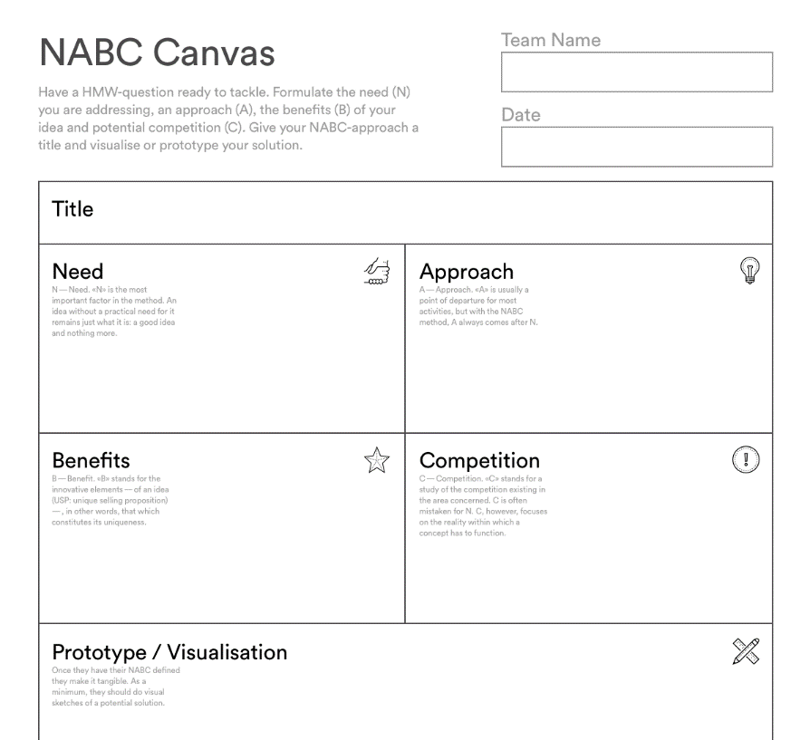
MACHINE LEARNING for Health tech
NABC PITCH
https://cdn-images-1.medium.com/max/1600/1*krTCBGCXulvn9wpSRsVQFg@2x.png

Slide 16
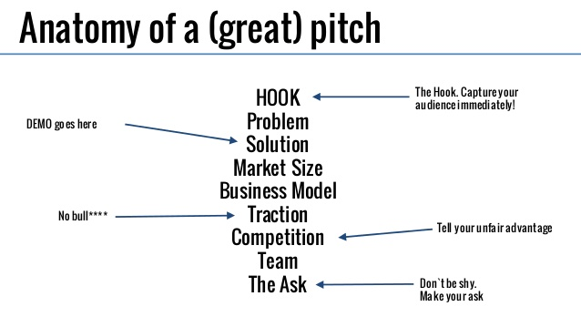
MACHINE LEARNING for Health tech
NABC PITCH

Slide 17
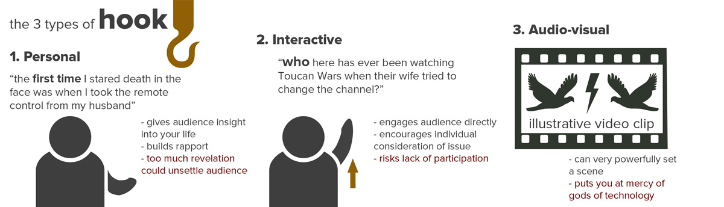
MACHINE LEARNING for Health tech
NABC PITCH

Slide 18

MACHINE LEARNING for Health tech
https://visme.co/blog/presentation-structure/

Slide 19
MACHINE LEARNING for Health tech
https://visme.co/blog/presentation-structure/

Slide 20
MACHINE LEARNING for Health tech
https://visme.co/blog/presentation-structure/

Slide 21
MACHINE LEARNING for Health tech
https://visme.co/blog/presentation-structure/

Slide 22
MACHINE LEARNING for Health tech
https://visme.co/blog/presentation-structure/

Slide 23
MACHINE LEARNING for Health tech
https://visme.co/blog/presentation-structure/

Slide 24
MACHINE LEARNING for Health tech
https://visme.co/blog/presentation-structure/

Slide 25
MACHINE LEARNING for Health tech
https://visme.co/blog/presentation-structure/

Slide 26

MACHINE LEARNING for Health tech
https://visme.co/blog/presentation-structure/

